Slide 1

Accenture Data & AI DAtathon
Datathon TEAM 3 - Metabolics
Diabetes Product Research & Development

Slide 2




Team 3
Data Analytics Team
Data Visualisation Team
AASHIK BHARATH EGNYA VARAHAN - Data Eng, Mgmt & Governance Sr Analyst
DAISY CALDER -
Business Architecture Analyst
AMIT VADHEL -
Data Architecture Manager
JOZEENE BAILEY -
Packaged App Development Analyst

Slide 3

Aim & METHODOLOGY

Slide 4
AIM
Summarise methodology and data used.
Generate insights into the impact of various factors on the diagnosis of diabetes.
Make recommendations in the context of relevant data analysis and research.

Slide 5






Methodology
Data cleaning and pre-processing of CSV data (data.csv) in Python using a Jupyter Notebook
Exploratory Data Analysis using Python (including relevant libraries) in a Jupyter Notebook
Output of cleaned dataset into a CSV file (clean_data.csv)
Load CSV file (clean_data.csv) to clean_data.db using sqlite via command line
Connect clean_data.db into Power BI using an ODBC SQLite connector to create a data visualization dashboard.
All files are managed using Git version control and uploaded to GitHub.
STORE
PROCESS
REPORT
(3rd party anonymised data)
data.csv
clean_data.csv
(clean_data.db)
Collaboration

Slide 6
Data Overview
Feature | Data Type | Data Category | Range
Age | Numeric | Continuous | 18 - 91
Gender | Text | Categorical | [female, male]
BMI | Numeric | Continuous | 1.8 - 52.9
Weight | Numeric | Continuous | 50 - 250
Family Diabetes History | Boolean | Categorical | [0,1]
Diabetes Pedigree Function | Numeric | Continuous | 0.2 - 0.8
Pregnancies | Numeric | Continuous | 0 - 5
Hypertension | Boolean | Categorical | [0,1]
Sleep Duration | Numeric | Continuous | 0 - 12
Diet Type | Text | Categorical | 12 types
Physical Activity Level | Text | Ordinal | 5 levels
Stress Level | Text | Ordinal | 4 levels
Alcohol Consumption | Text | Ordinal | 4 levels
Social Media Usage | Text | Ordinal | 4 levels

Slide 7
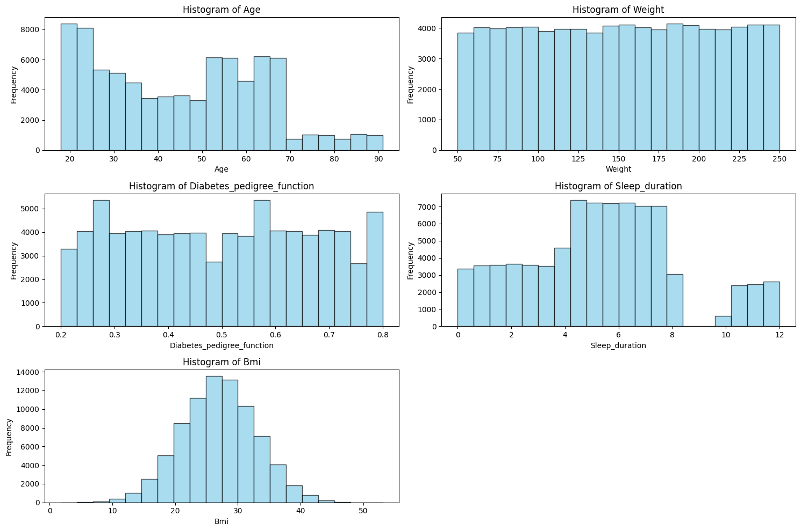
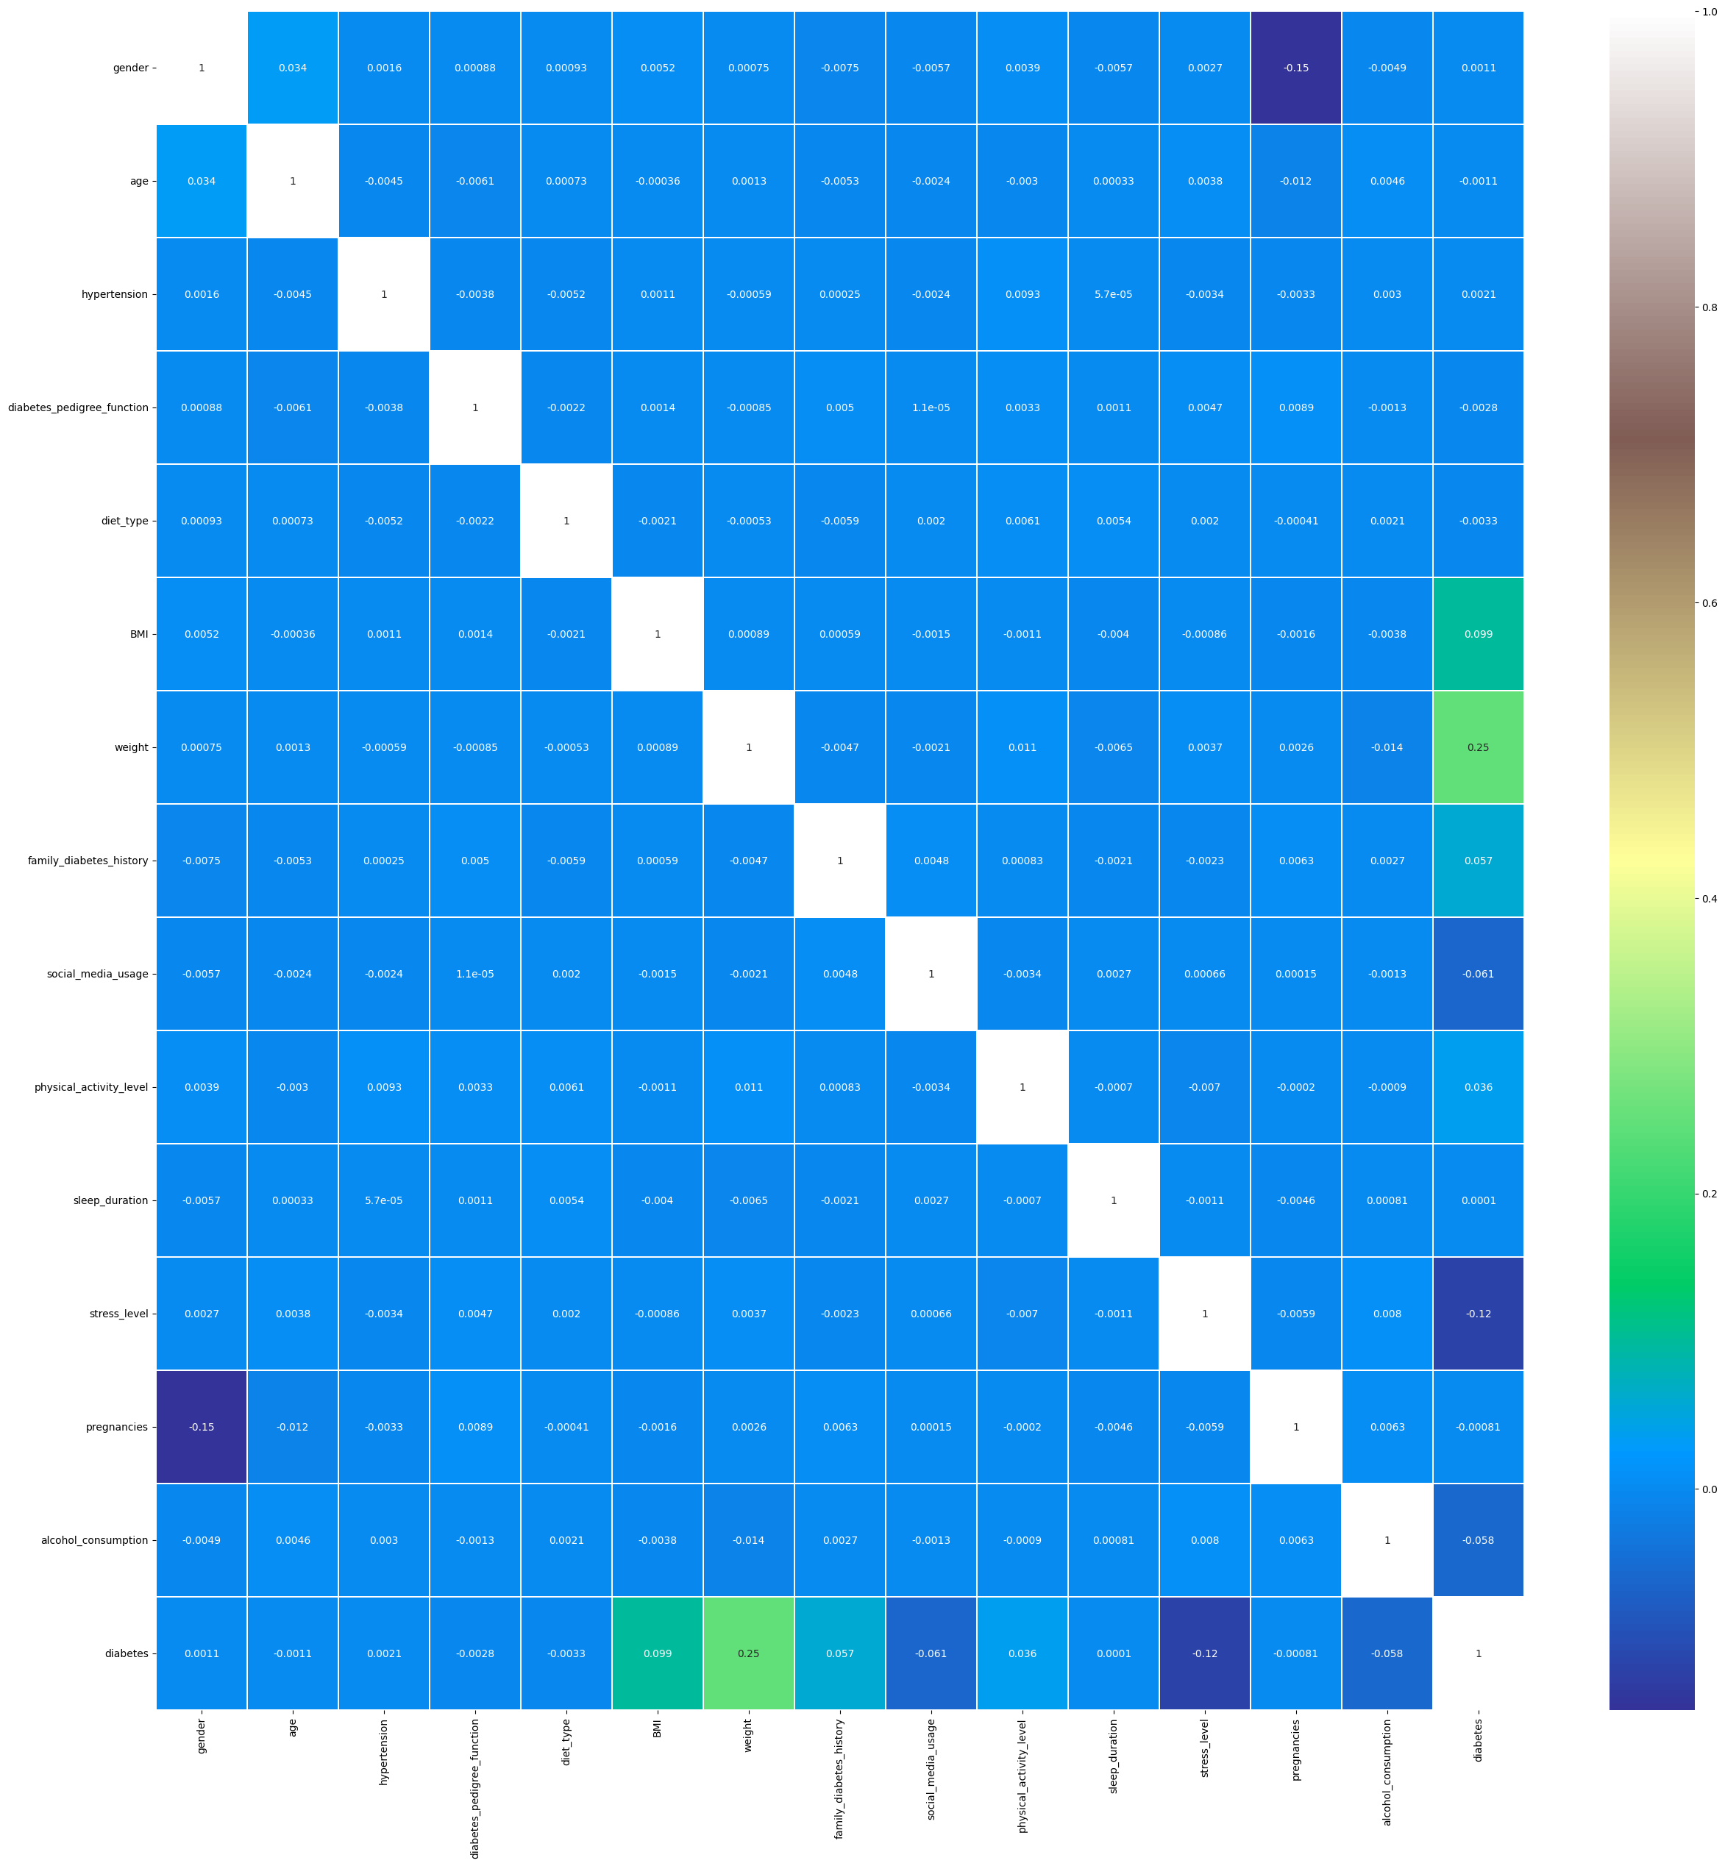
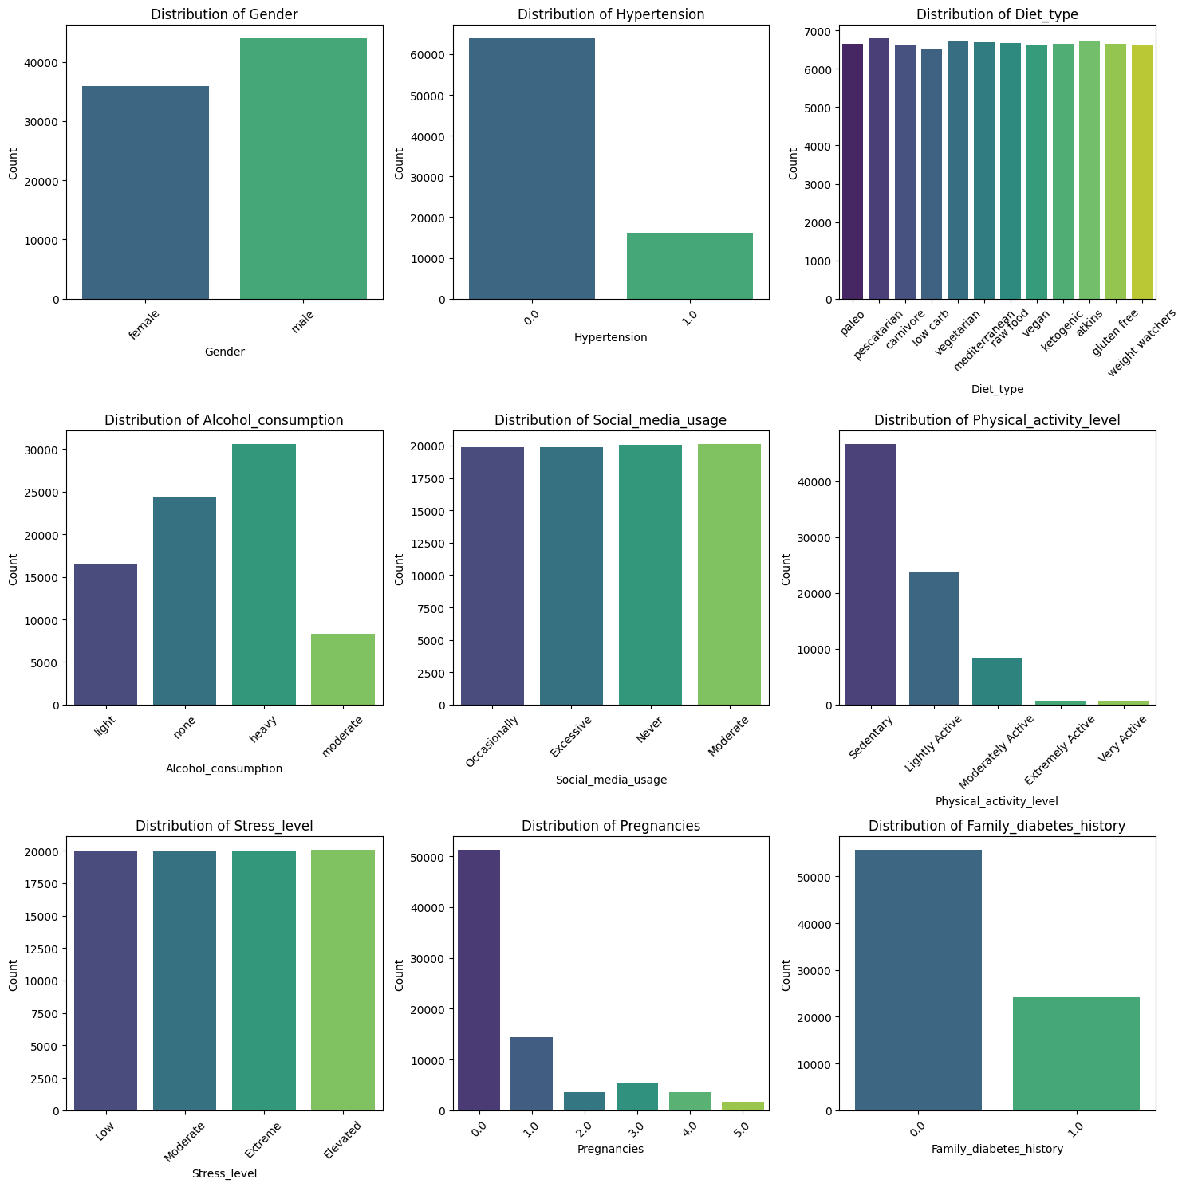
Exploratory Data Analysis
A Comprehensive View of Our Data: From Distributions to Correlations

Slide 8
INSIGHTS & IMPLICATIONS

Slide 9
Research Questions
Together, We Can Fight Diabetes
How does diabetes affect males vs females ?
What is the prevalence of diabetes across age and gender group?
How many people live with both hypertension and diabetes? How does having hypertension impact the likelihood of having diabetes?
How much does a family history of diabetes impact a person’s chance of having diabetes?
How does lifestyle affect diabetes? (i.e. diet, alcohol consumption, physical activity, sleep, stress, social media usage, etc.)

Slide 10
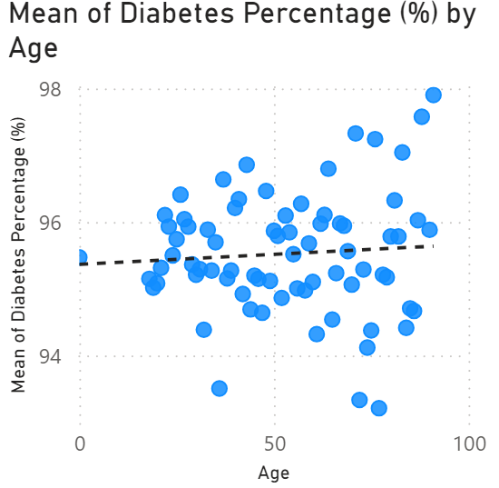
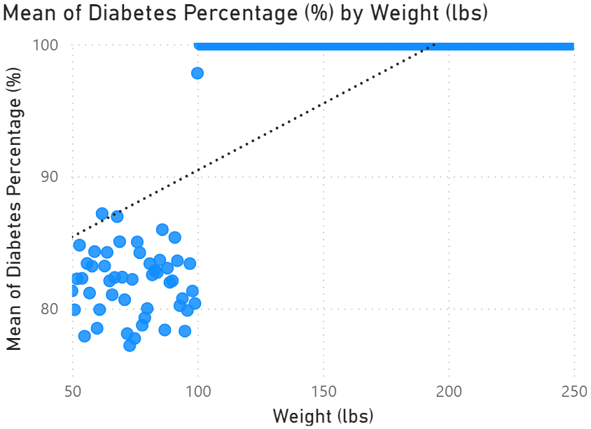
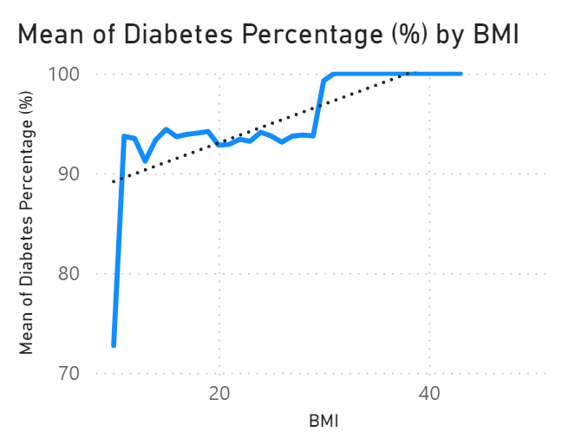
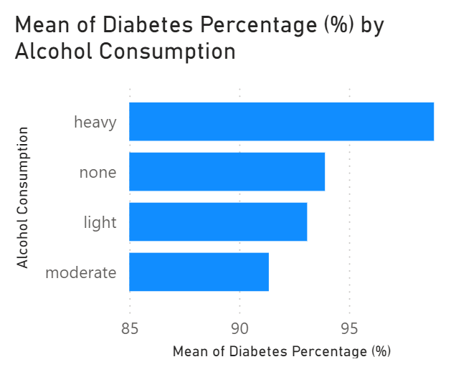
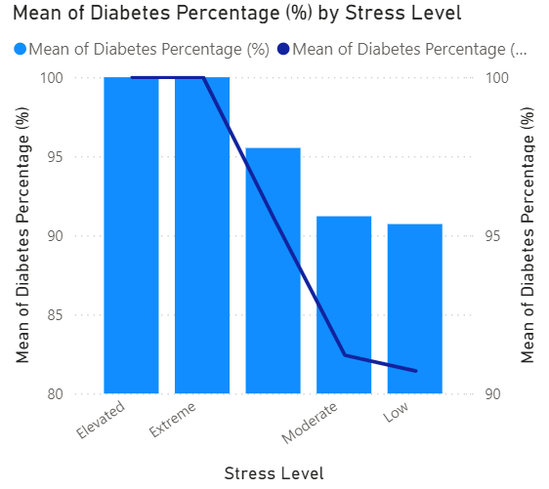
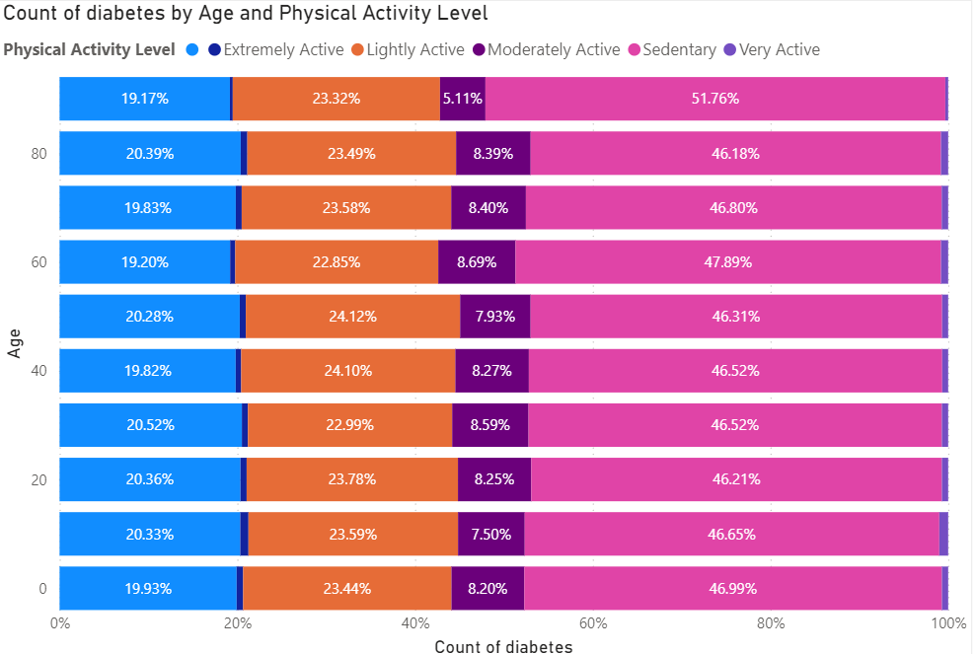
6 Features affecting DIABETES
Age, Weight, BMI, Alcohol Consumption, Stress Level, Physical Activity

Slide 11
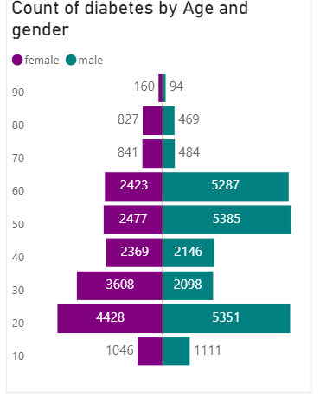
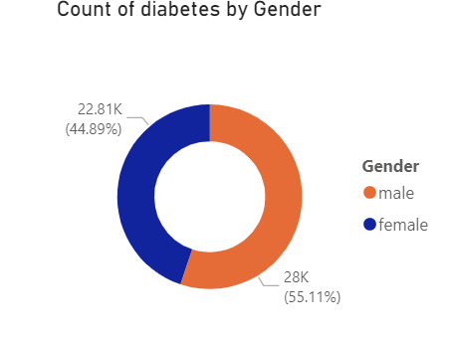
2 Special Cases
Correlation between Gender and Diabetes does not take into consideration key factors (types, lifespan)

Slide 12
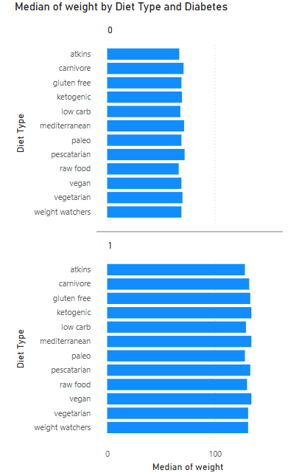
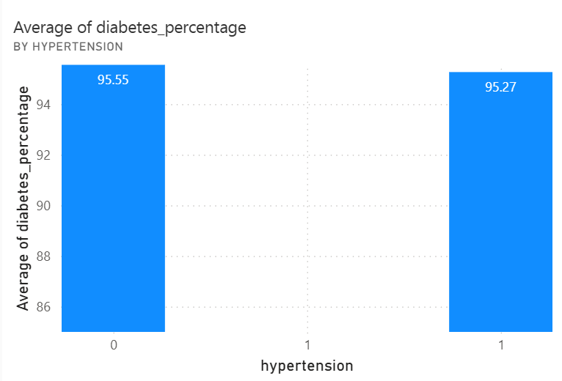
2 Features not affecting Diabetes
Diet Type, Hypertension

Slide 13
RECOMMENDATIONS

Slide 14
A Healthier, Happier You
Outcomes:
Improved Physical Health:
Weight Management: Our weight loss medications, combined with partnerships with fitness centres, help individuals achieve and maintain a healthy weight.
Portable Concealable Medical Devices: Insulin pumps and Continuous Glucose Monitors suited for the active lifestyle.
Enhanced Mental Health:
Stress Reduction: Our anti-anxiety treatments, coupled with therapeutic support, provide relief from stress and anxiety, promoting mental clarity and emotional well-being.
Reduced Substance Use:
Alcohol Consumption: Our appetite suppressants can help curb alcohol cravings, leading to healthier lifestyle choices.
Boosted Self-Confidence:
Anti-Aging Solutions: Our anti-aging products help individuals look and feel their best, boosting self-esteem and confidence.
Notes:
1. Increase in physical activity, lifestyle – Weight reduction medications which will not have any side effects along with offers to join Gyms
2. Mindfulness and Stress level control – Anti-anxiety treatment (medications + therapy)
3. Appetite suppressants to reduce alcohol consumption along with offers from grocery stores
Drug Discovery
Reducing alcohol consumption – alternatives (GLP-1 agonist)
Synergistic drugs
Improving drug efficacy
Vegan drugs like Metformin
Managing and Monitoring diabetes in children.
Marketing: Consider the social media usage data
4. Anti –ageing products to help you look great and be confident

Slide 15
Research opportunities
Type 1 v Type 2 Diabetes
What are the different needs between Type1 vs Type2 patients?
What are the different ways patients take our drugs?
How is the disease prevalence changing between types over time?
Other drug markets
Weight-loss drugs (tackling off-label prescription) - GLP-1 agonist
Hypertension drugs
Social media marketing channels
How do diabetics use social media for managing the disease?
What social media platforms are being used by patients?
What age groups use social media the most?
Additional Parameters
Historical Data (societal and preferential changes)
Geographical data (markets)

Slide 16



THANK YOU
ACCENTURE
Team 3
+44 1239 876 554
datathon@accenture.com
www.accenture.com

